Slide 1
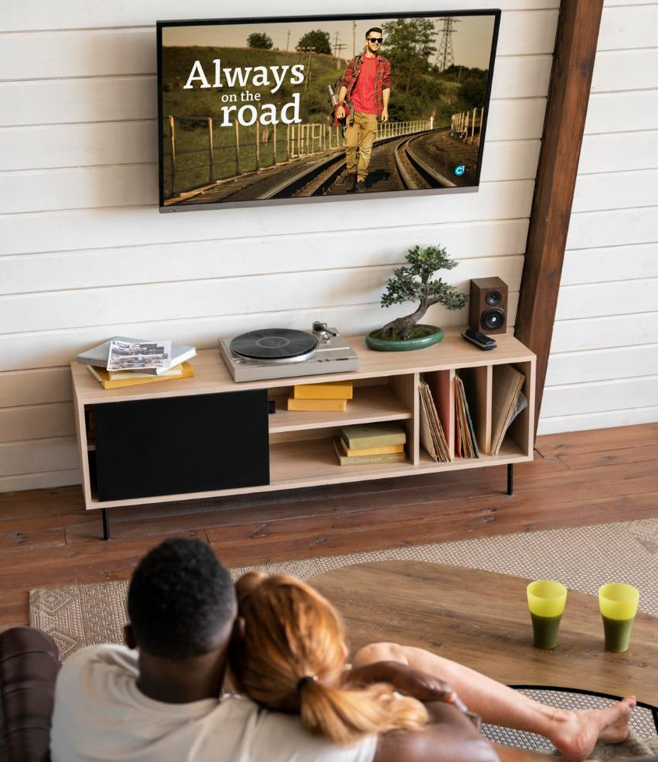
BRIGHT TV Viewship ANALYSIS
September 2025
Presented by Tamara.G

Slide 2
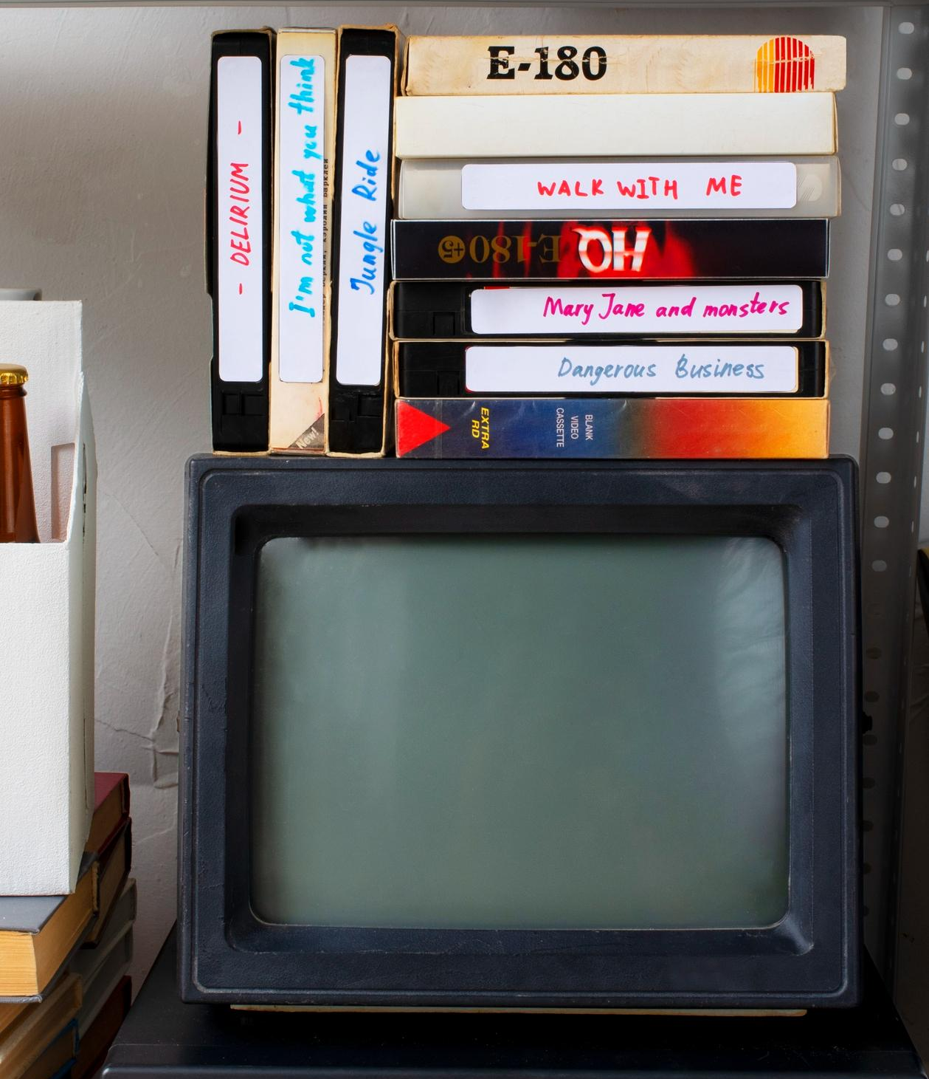
Understanding The data
Sample Size
1000 users
Duration
Jan – March 2016
Channel Genres
Sport, Music, Entertainment, Movies
Race
Black, White, Indian, Coloured
Gender
Male/Female
Time Slots
Early morning, Morning, Afternoon, Evening & Night
Total Viewing Time
1134 Hours
Most shows were viewed for less than an hour.

Slide 3

Viewership Split by Province
36% -Gauteng has the most number of viewers with 357 viewers.
3% -Northern Cape has the least number of viewers with 25 viewers.
Nulls -No Province- 24 with No Info.

Slide 4
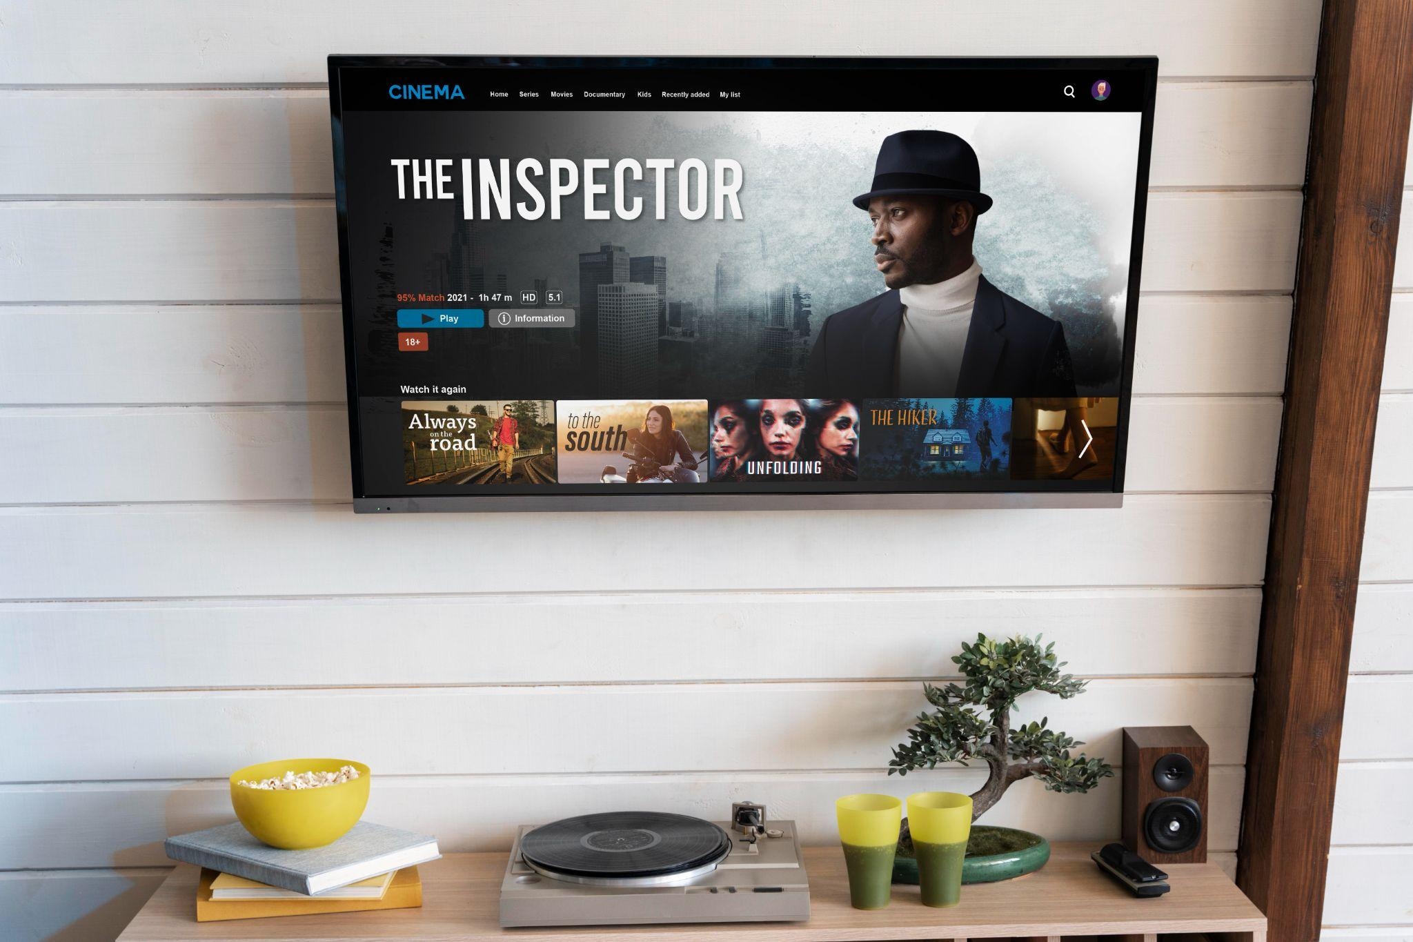



Top 5 Most-watched shows by Viewers
Sport shows watched made up 50% of the views.
Music channels made up 36% of the views.
Top 5 shows make up 60% of the total viewed shows.

Slide 5
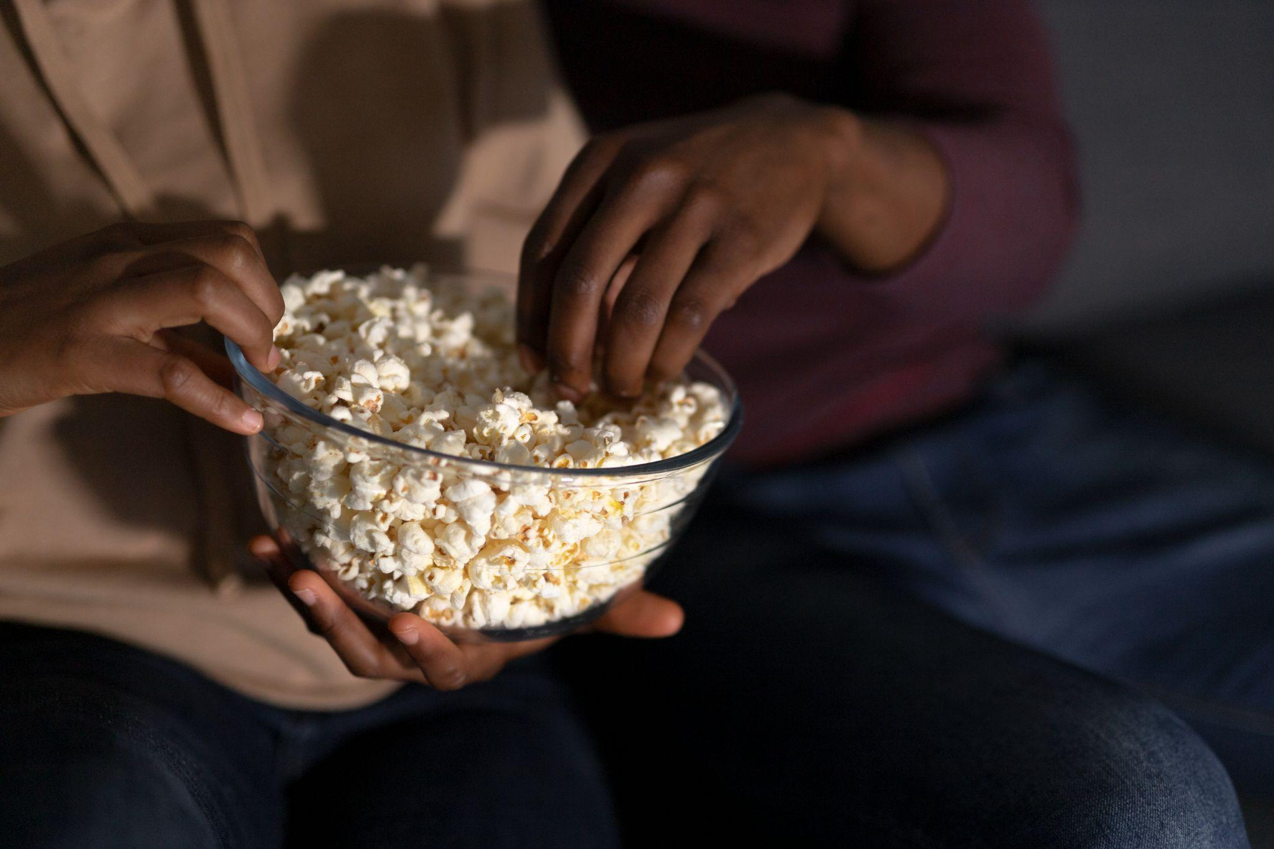
Viewership by Time of the Day & Age Group
The Most views were by the Youth age group with 54.35% of the total &
Youth age group makes up 55% of the Afternoon views.
Adults & Youth make up the most views- combined 82.4% of the total.
The Least views were by the Kids age group throughout the day with 0.9% views.

Slide 6
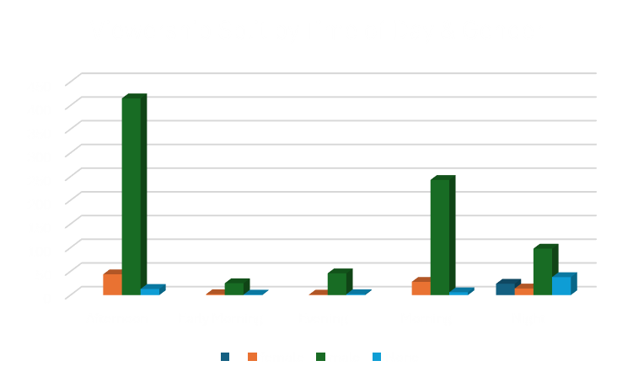
Viewership Split by Time of the Day & Gender
Female viewers - 9%
Male Viewers – 82.7%
Peak times with the most views is Afternoon and Morning Times with 75% of Total views.
Males make up 88% of the total Afternoon views.
The Least views is during the Early morning with 2.8% of all genders.
Nulls – 6% who did not provide information.

Slide 7
Viewership Split by Month & Channel
45% of Total views were from the Month of March due to the ICC Cricket world cup being shown. This contributed to 26% of the March views.
Sports contributed to the highest consumption of 50% during the March month.
The least views were consumed in January with 19% of total views and gradually increased in February to 29% and thereafter 45% in March.

Slide 8
Insights on User Demographics & Volume
83%
41%
36%
Gender Skew
Racial Skew
Geographic Hub
The Black demographic group drives the highest volume of viewing sessions – 41% of Consumption.
Strong Male dominance in viewing sessions , approximately 83% consumption.
Gauteng is the Primary Market by volume of viewing sessions.

Slide 9
Insights Summary
Audience and Content Performance Insights
Dominant Audience
Peak usage
Consumption
Top Content
Afternoon and Morning are the Peak viewing times.
Fridays & Saturdays have the highest viewing sessions.
Sports and Music dominate the Consumption.
Youth & Adult Age Group Most Active.

Slide 10
Factors Affecting Consumption
Content Type
Content Localization
KEY FINDING: Sports (Super sport Live Events, ICC Cricket) and Music (Channel O, Trace TV) account for the largest session volume. These channels are primary retention anchors.
KEY FINDING: The Black demographic’s top channel is channel O(Music & entertainment) while the Indian/Asian demographics top channel is ICC Cricket World Cup 2011(Sports).
Age and Habit
Competition
KEY FINDING: Youth users primarily view in the afternoon and Morning. Elders view significantly at the night.(71%) .Consumption is driven by lifestyle.
KEY FINDING:
The South African Market is ccompetitive with strong local players and global giants such as Netflix and Showmax. Affordibility is a majot reduction and BrigthTv pricing and value must competitive offering low cost tiers

Slide 11
Content and Scheduling Recommendations
Monday MUSIC Mayhem
Repurpose Peak Content
Targeted Push Notifications
Monday Music Mayhem: The strategy of implementing the Monday Music Mayhem a successful driver for music channels to play music content on channels like Trace TV & Channel O. This will drive up consumption on the low performing days of the week. (Monday & Tuesday) at a low viewing time to boost consumption.
(Hook): Repurposing weekend Peak Content
To boost engagement on your lower days, repeat Saturday and Sunday content to drive viewers back on Monday (lowest views). Sport games & music.
The Call to Action: Aiming to drive up views to address Monday viewership slump.
Since Monday and Tuesday is your lowest engagement day, targeted push notifications can trigger and push audience as a reminder to not miss a repeat or upcoming show, which is essential to drive up traffic.

Slide 12




Conclusion & Insights
Add shows to cater for the least viewing audience which is the WHITE Female, boost their viewership by conducting research on what the minority would find engaging and boost views during the week.
Provide more engaging shows in the genre of Music and Sport to cater for the Highest viewing audience which is BLACK middle-aged males.
Air repeats of memorable repeats such as championship final sport games during low time intervals during the evening & early morning to boost consumption and engagement of views.

Slide 13
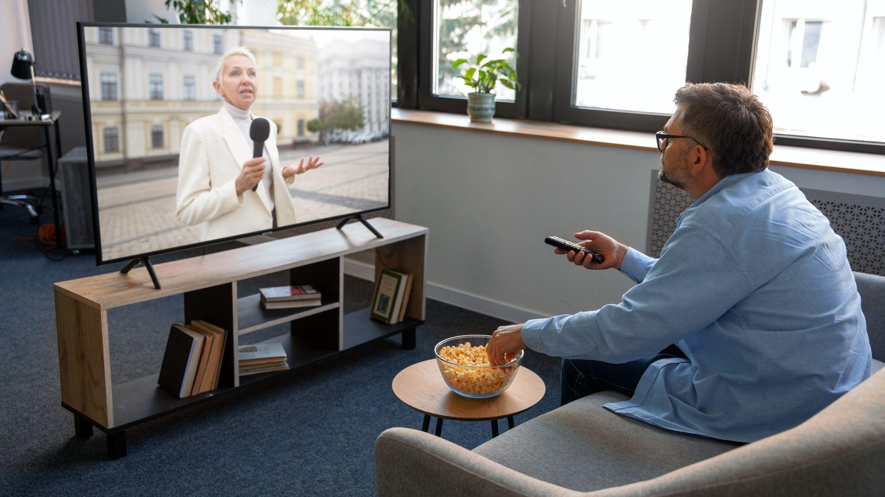
THANK YOU!
DO YOU HAVE ANY QUESTIONS?
tamaragovindsamy@gmail.com

